Slide 1





Social Media impact on News
Sentiment analysis via Twitter and YouTube
By
Jiemei, Ashish and Megulo

Slide 2
Question to explore...
Which is preferred platform?
Expectations from different platforms.
How people are reacting these news?

Slide 3
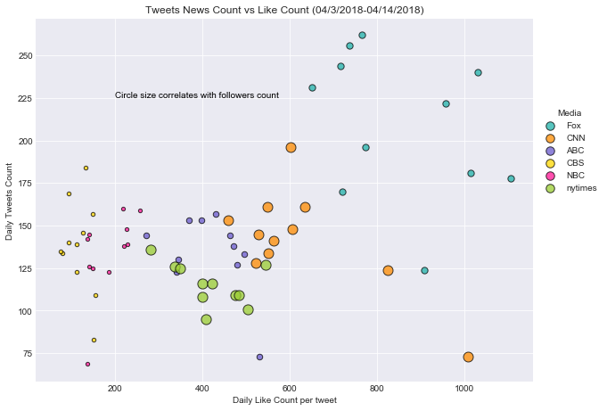
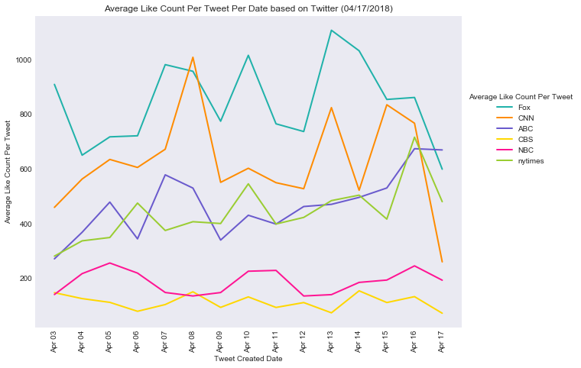
Different media same platform(Twitter)

Slide 4
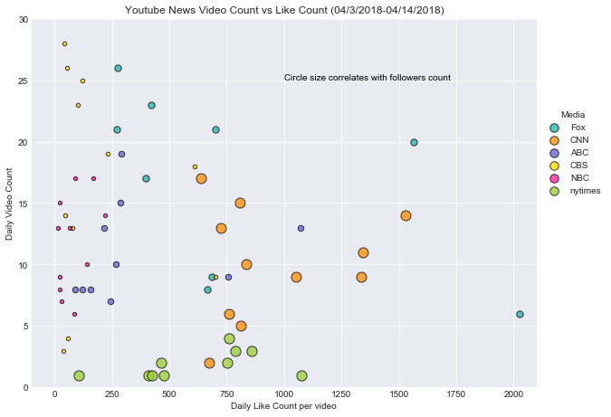
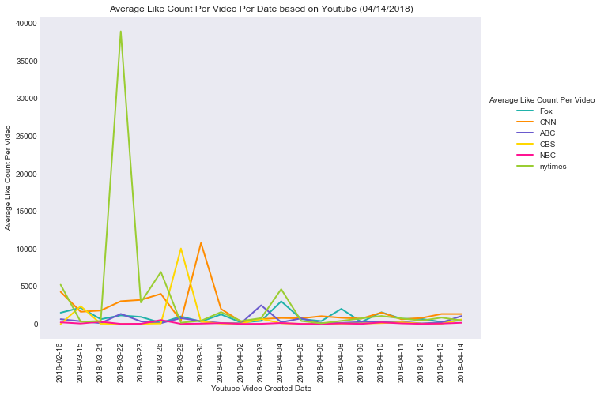
Different media same platform(YouTube)

Slide 5
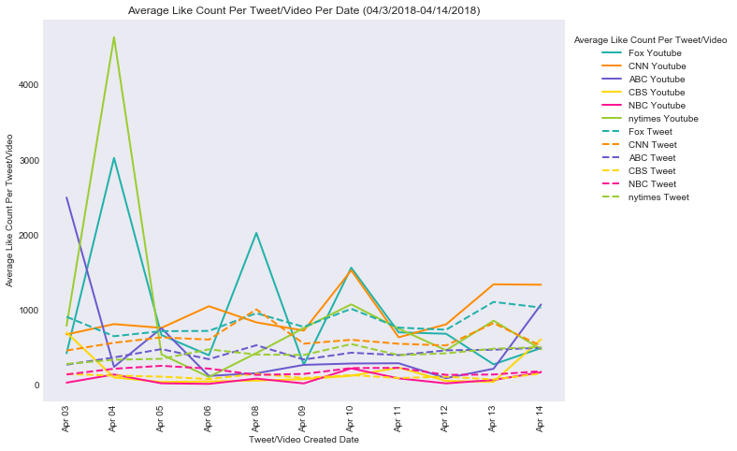
Platform summary

Slide 6
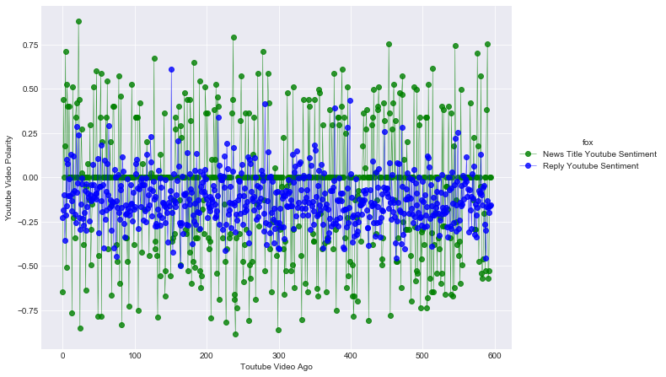
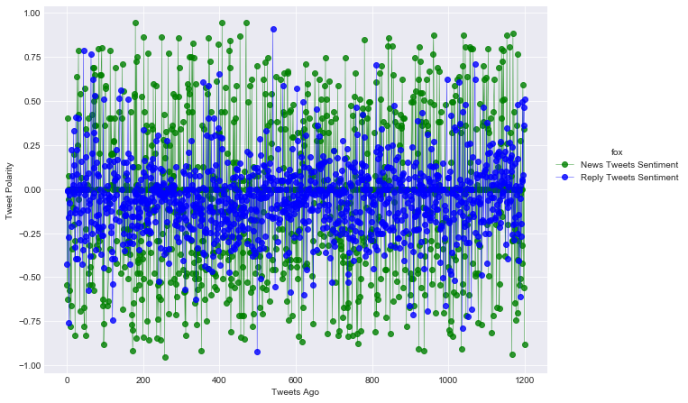
Reaction to tweets VS videos
FOX NEWS

Slide 7
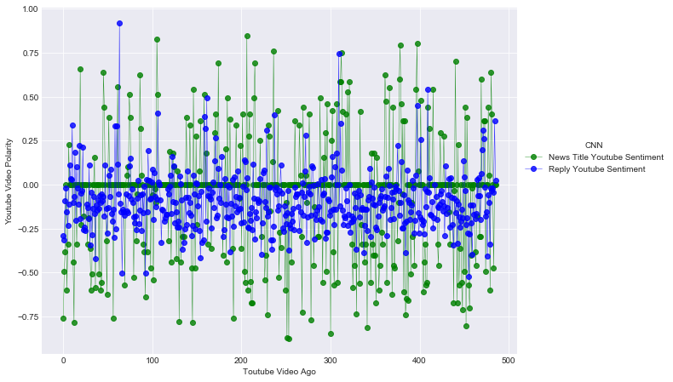
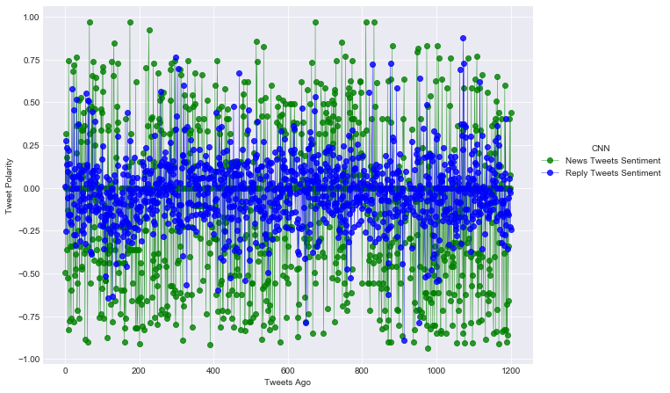
Reaction to tweets VS videos
CNN NEWS

Slide 8
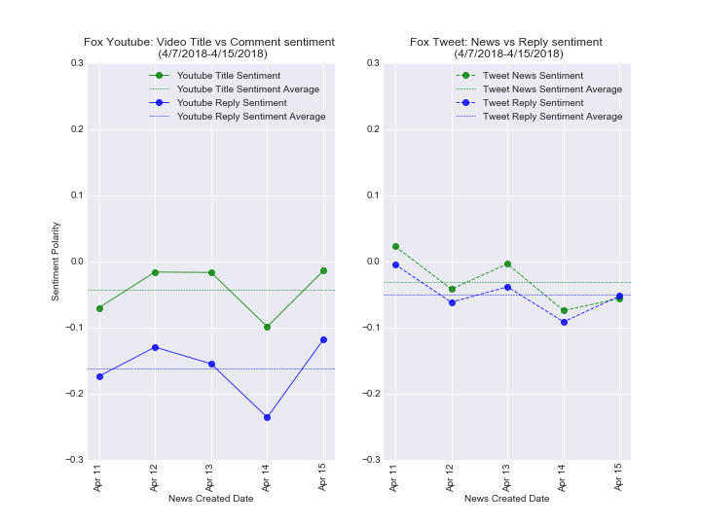
Twitter VS YouTube reply sentiment
FOX NEWS

Slide 9
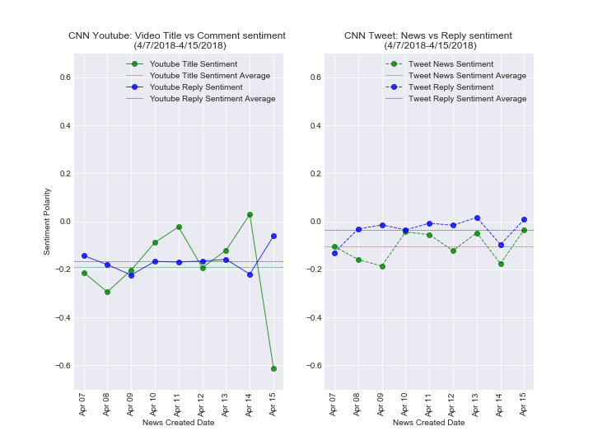
Twitter VS YouTube reply sentiment
CNN NEWS

Slide 10
Conclusion…
YouTube is the preferred medium for major events.
In twitter world more tweets provides more likes whereas in YouTube more followers provides more likes.
Sentiments are strongly expressed for visual contents

Slide 11

This Photo by Unknown Author is licensed under CC BY-SA

Slide 12
Our journey taught us…
Finding dataset and designing model is an art.
Teamwork is a key
Thank you Twitter, YouTube, Stackoverflow, Jacob, Luis and Brandon

